Slide 1
From Alert to Notification SAP APM

Slide 2





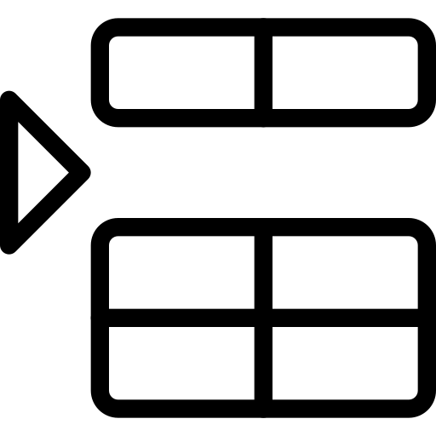

From Alert to Notification
Configuring Rules
Rule
Monitoring Alert
Manage Alert Type
Manage Rules
Monitor Alerts
Costumize Conditions
Create Notification to S4H
Create
Alert Type
Create Rule
Insert Triggerd Value
Identify Alert

Slide 3
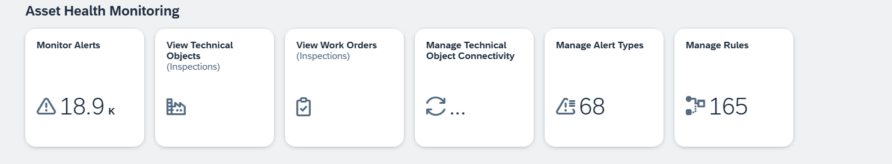
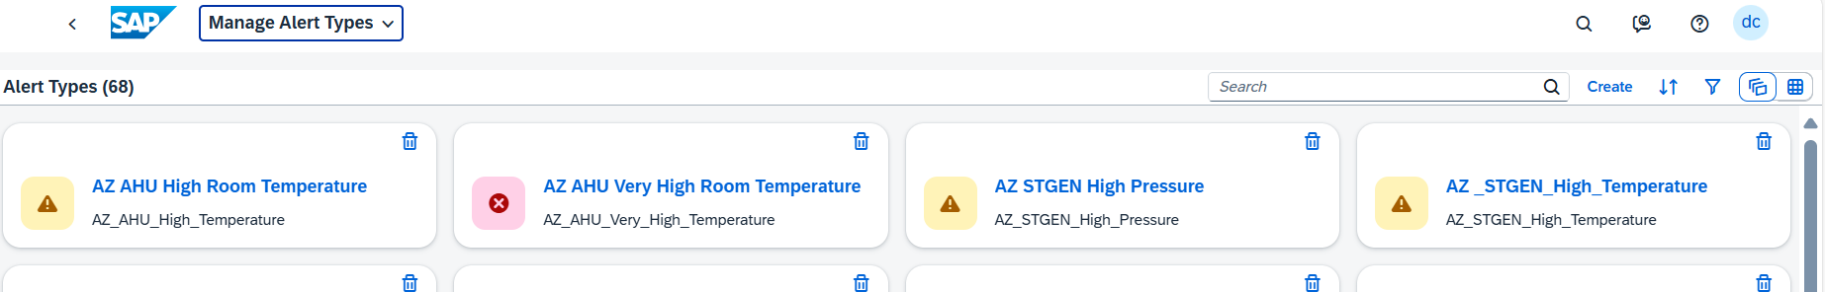
How to create an Alert Type? Step by Step

Slide 4
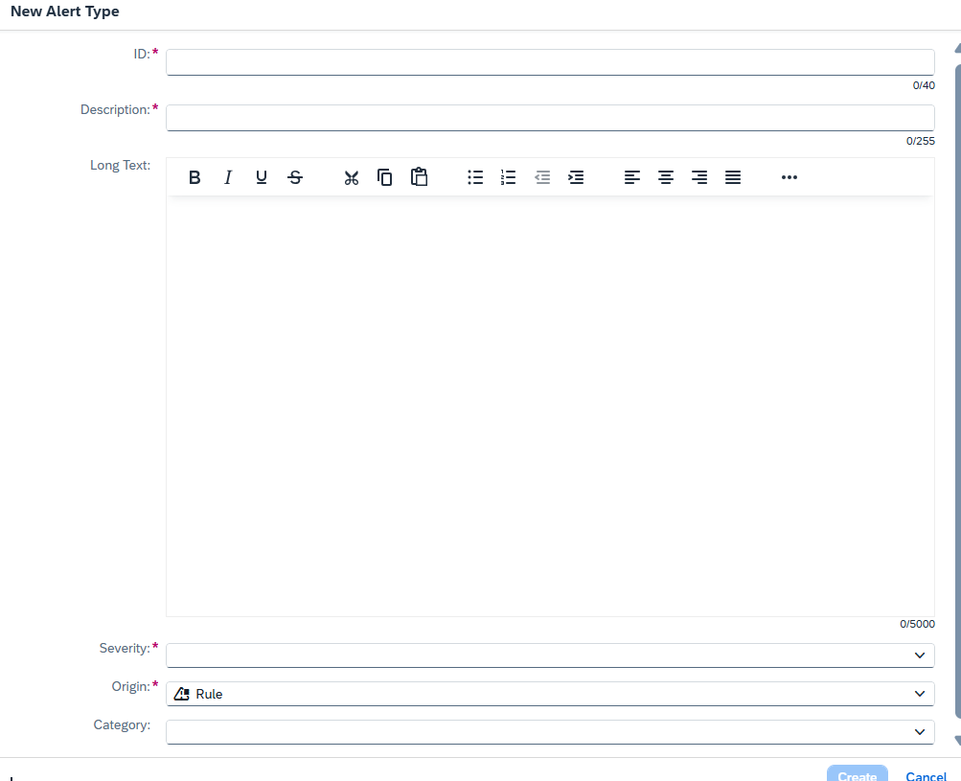


How to create an Alert Type? Step by Step
ID
DESCRIPTION
SEVERITY
ORIGIN

Slide 5
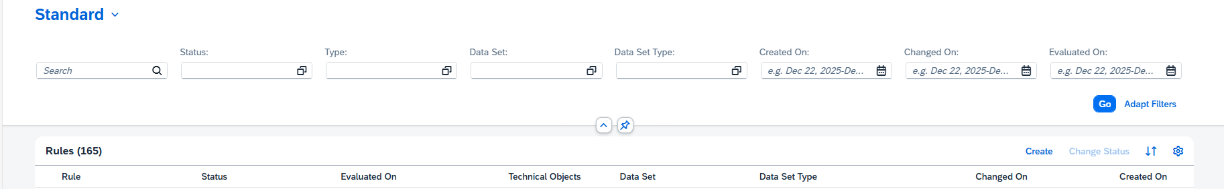
How to create a Rule? Step by Step

Slide 6
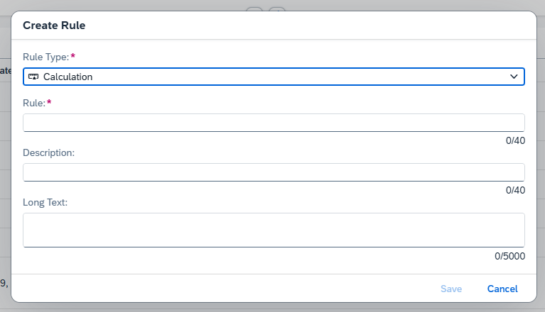
How to create a Rule? Step by Step
TYPE
RULE (NAME)

Slide 7
Type of Rules
Calculation
Use indicator and attribute data to calculate other indicators. 👉 Example: Calculate pump efficiency using pressure and flow rate.
Aggregation
Aggregate data in the asset hierarchy using Min, Max, or Average functions. 👉 Example: Get the maximum temperature of all pumps in a plant.
Scheduled
Run on a defined schedule to trigger Alerts or Notifications. 👉 Example: Send a daily alert if vibration exceeds the allowed limit.
Streaming
Trigger in real-time when data updates. 👉 Example: Notify immediately when pressure drops below the critical threshold.

Slide 8
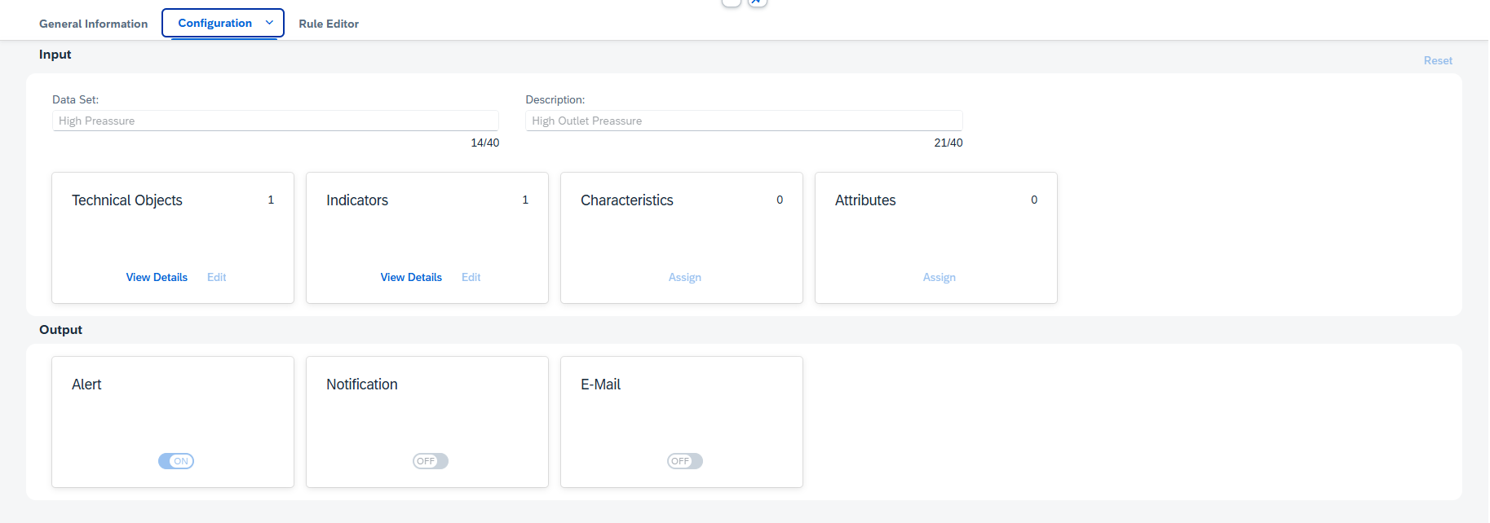



How to create a Rule? Step by Step
Statatic o Dimanic
Techobjet or Groups
Selection of Indicator to monitoring
Selection of kind of output

Slide 9
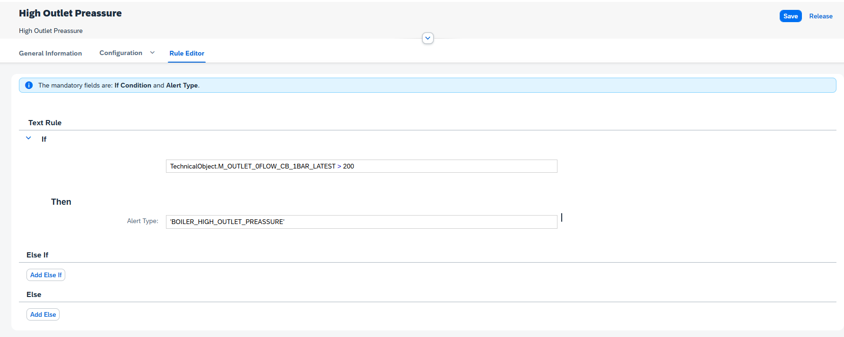
How to create a Rule?
Alert Type created previously

Slide 10
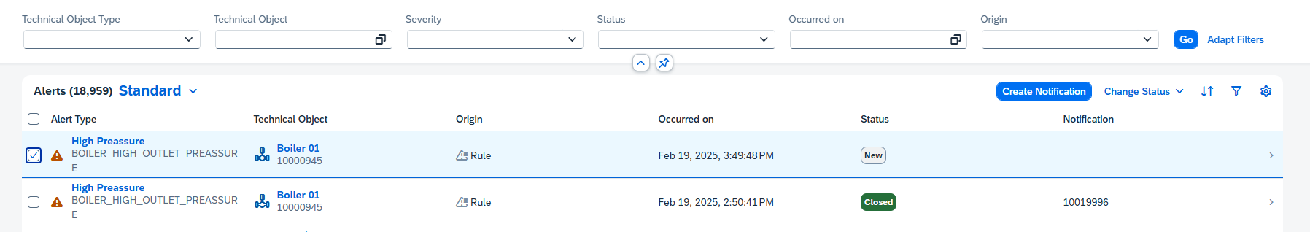
How to create a Notification from an Alert? Step by Step

Slide 11
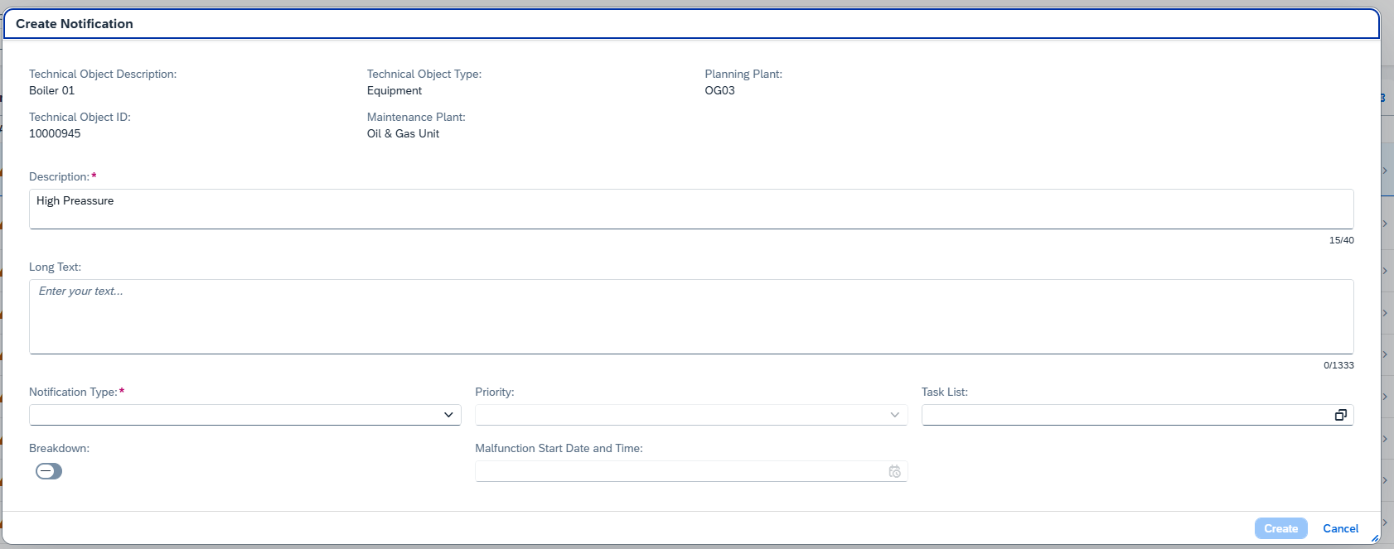
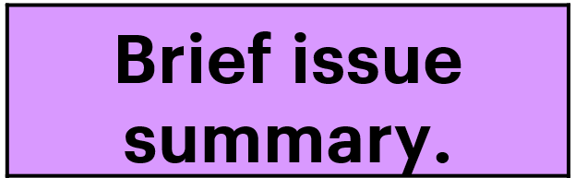
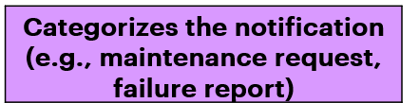
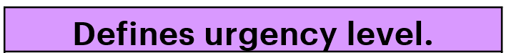
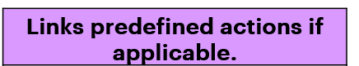

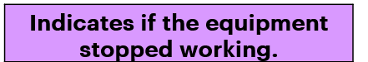
How to create a Notification from an Alert?

Slide 12

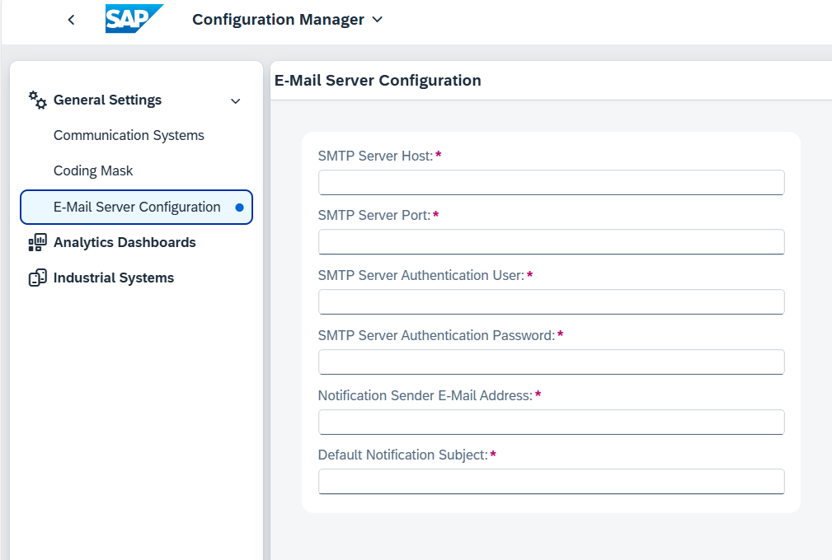
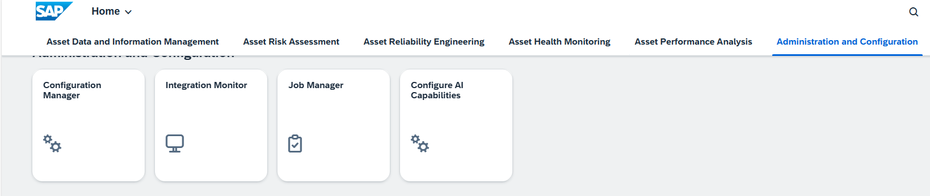
How to receive an e-mail notification?

Slide 13
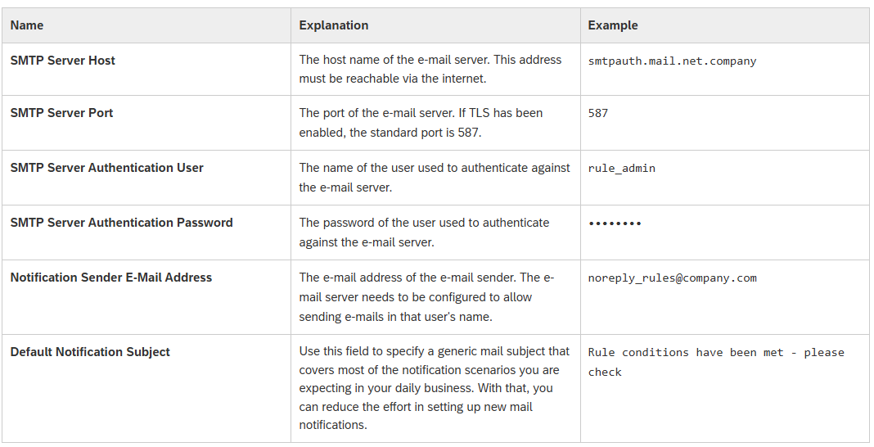
How to receive an e-mail notification?

Slide 14
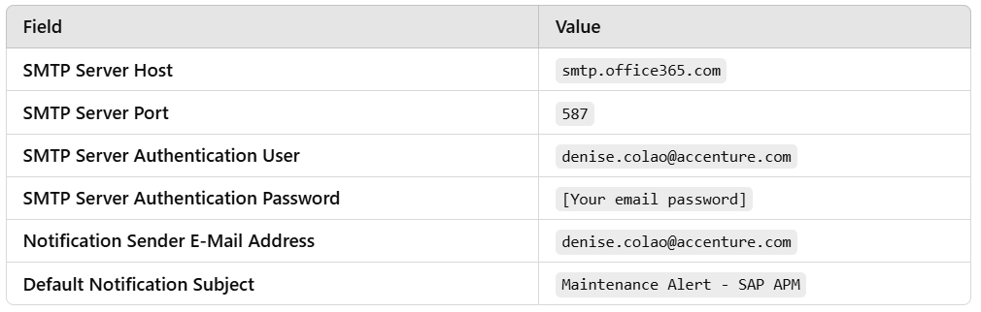
How to receive an e-mail notification?
Example

